Slide 1
Observance of World Lung Day 2021: Bangladesh Lung Foundation

Slide 2
Summary of activities
Main observance ceremony at capital, Dhaka with celebrities from various sectors
Spirometry workshop
CME seminar at large zonal city- Cumilla
COVID training session (USAID funded) witnessed by US Ambassador
Mask and educational material distribution among underprivileged children
Awareness generation through river cruise

Slide 3
BLF is a World Lung Day Partner with FIRS
BLF World Lung Day, 2021 Poster

Slide 4
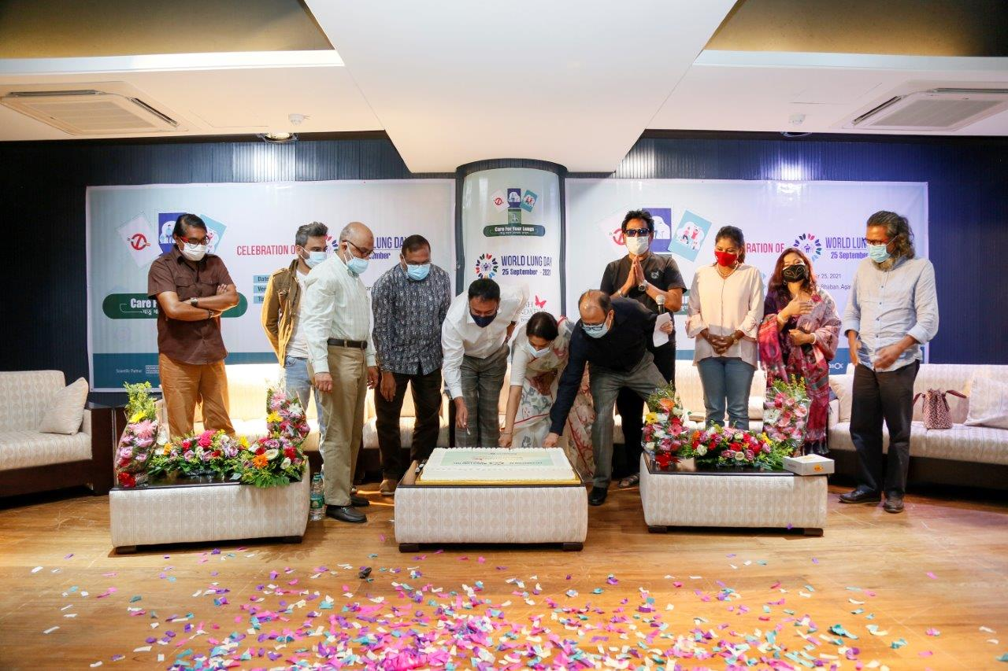
Cake cutting with invited celebrities

Slide 5
President of BLF’s speech

Slide 6
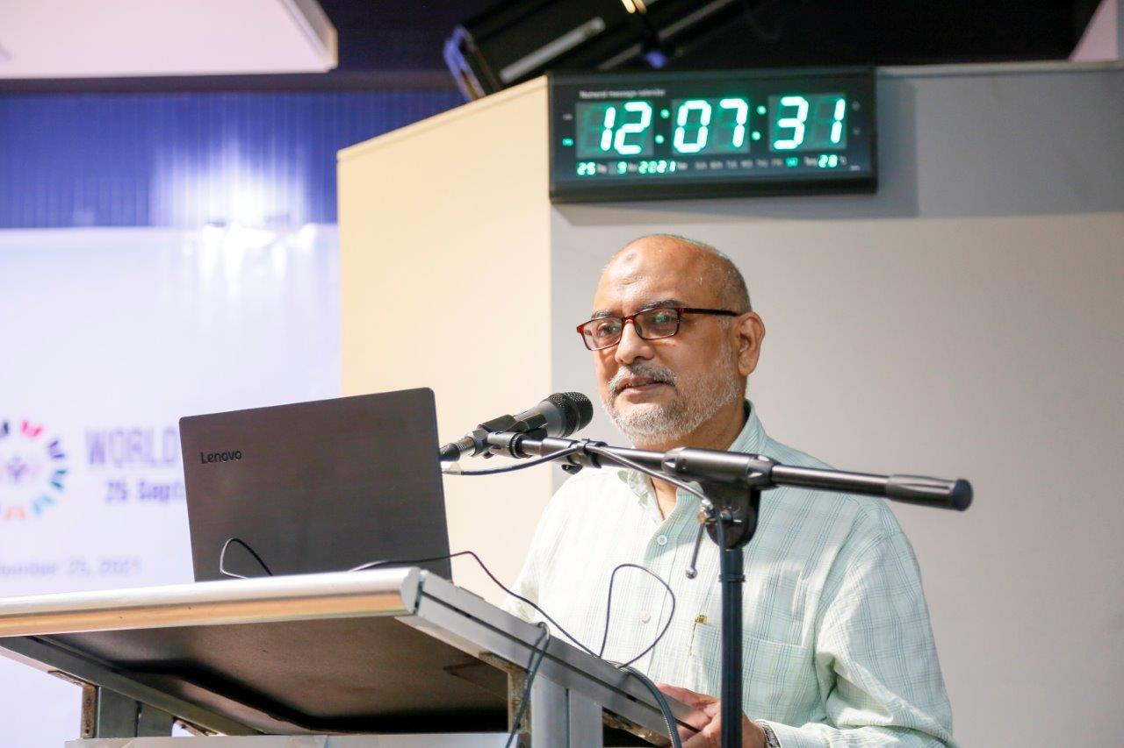
Secretary General, BLF making presentation

Slide 7
Master of Ceremony- Treasurer, BLF

Slide 8
Joint Secretary, BLF welcoming the guests

Slide 9
National Award winning TV and movie star-Zahid Husssain

Slide 10
CEO, Bangladesh Environmental Lawyer’s Association

Slide 11
Music Composer and Rockstar - Habib Wahid

Slide 13
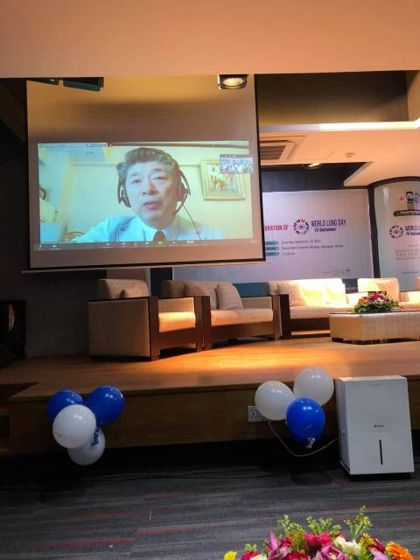
President APSR – Prof. Yoichi Nakanishi joins through internet

Slide 14
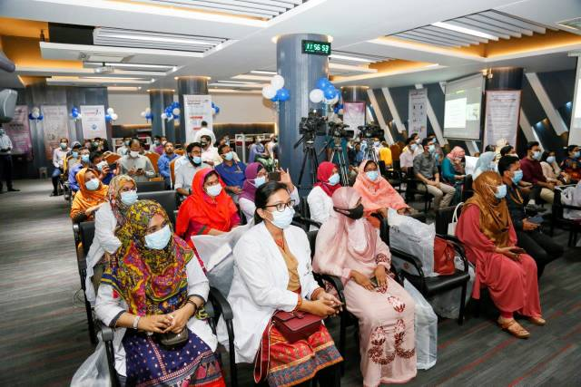
Audience at main observance meeting

Slide 15
Scientific seminar at a large zonal city- Cumilla

Slide 16
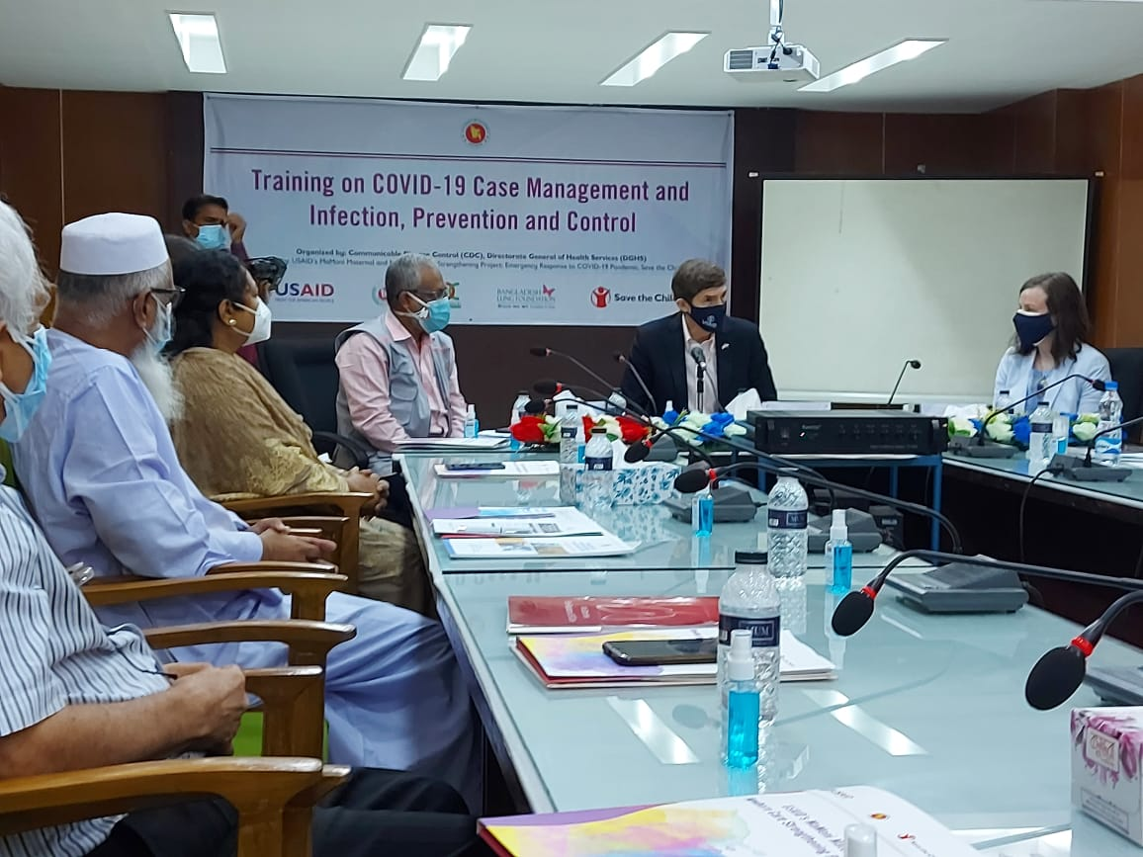
H.E.US Ambassador to Bangladesh joins COVID training session at Cumilla Medical College

Slide 19
Invitation card to main ceremony in the capital, Dhaka

Slide 20
Hands-on training at Spirometry Workshop

Slide 22
Smiling faces of workshop participants

Slide 23
Mask and educational material distribution among underprivileged children

Slide 24
Awareness generation through river cruise

