Slide 1
World Lung Day Report 2021
Indonesian Respiratory Society

Slide 2
World Lung Day 2021
World Lung day on September 25 is a day of awareness and appreciation for lung health, a change for us to come together and promote improved lung health around the world
Indonesia Respiratory Society (ISR) has 1,282 pulmonologists around Indonesia
ISR vision: To become a professional, integrated and leading professional organization to support the Indonesian’s lung health as high as possible

Slide 3
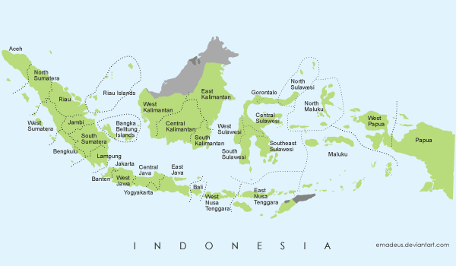
Pulmonologist Distribution in Indonesia
= 1 – 10
= 11 – 50
= > 50
53
126
3
10
6
2
47
13
2
27
3
1
11
6
11
10
2
49
212
21
7
5
17
109
25
7
8
46
146
238
16
23
14
6

Slide 4
ISR World Lung Day 2021 Activity
For Pulmonologist
Updated Lung disease webinar
For Community
Community engagement
Webinar education
Talk show

Slide 5
Indonesian Respiratory Society: Malang Region (1)

Slide 6
Indonesian Respiratory Society: Malang Region (2)

Slide 7
Indonesian Respiratory Society: Malang Region (3)

Slide 8
Indonesian Respiratory Society: Malang Region (4)

Slide 9
Indonesian Respiratory Society: Malang Region (5)

Slide 10
Indonesian Respiratory Society: Banten Region

Slide 11
Indonesian Respiratory Society: East Java Region

Slide 12
Indonesian Respiratory Society: Jakarta Region

Slide 13
Indonesian Respiratory Society: Lampung Region

Slide 14
Indonesian Respiratory Society: Lampung Region (2)

Slide 15
Indonesian Respiratory Society: Kalimantan Region

Slide 16
Indonesian Respiratory Society: Lombok Region

